Slide 1
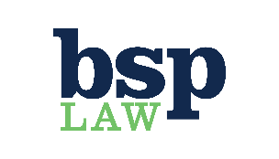
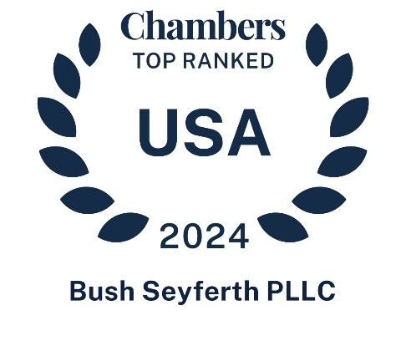
Helping Clients Navigate
The Fine Line Between Success and Failure
Trial Practice
We are a law firm of business-minded trial attorneys with a proven track record of defending Fortune 500 clients in complex and high-exposure cases across the country.
Class Actions
BSP Law brings its trial-focused approach to the biggest class actions and mass actions, deploying its deep bench to defend clients in a range of industries.
Complex Business Litigation
Combining practicality, aggression, and proportionality to craft effective strategies for a broad range of business disputes, BSP Law is ready to go the distance and poised to drive more favorable outcomes along the way.
Critical Motions & Appeals
BSP Law uses dipositive motions, Daubert challenges, and other strategic motions to earn decisive victories at any phase of litigation. When it needs to, BSP Law is also ready to take the fight to appellate courts.
National Discovery & eDiscovery
National Discovery Counsel for a major automotive manufacturer for 2 decades. BSP Law leverages technology and extensive discovery knowledge to efficiently handle large-scale eDiscovery matters.
Product Liability Defense
BSP Law has successfully defended more than 200 catastrophic product liability cases across the country.
Cybersecurity & Emerging Technologies
BSP Law uses its experience and technical knowledge to counsel clients on emerging technologies and assist clients addressing cybersecurity and autonomous vehicle matters.
Representative Clients
Automotive / Trucking
Ford Motor Company
Mercedes-Benz USA
Stellantis
Roush Industries
U-Haul International
Nissan North America
Financial / Insurance
FDIC
KeyBank
Transamerica Life Companies
Nationwide Insurance
Meadowbrook Insurance Group
Prudential Insurance
Retail / Technology
PulteGroup
FordDirect
Merck
Coca-Cola
Kroger
SAS Institute
123.Net
BSP Law Is Proud To Be
Benchmark Litigation’s Michigan Firm of the Year (2023, 2024)
Ranked in Chambers and Partners 2024 USA Guide for Product Liability: Automobile (Nationwide) and Litigation: General Commercial (Michigan)
Mansfield Rule Certified Plus, 2022-2023
The Trial Network’s Michigan Firm
National Coordinating and Trial Counsel – major automotive manufacturer
A Sustaining Member of PLAC
Named PulteGroup’s Law Firm of the Year
A member of The National Association of Minority & Women Owned Law Firms from 2009 to 2022, and past winner of their Law Firm MVP award in 2016.
Troy, Michigan | Houston, Texas | bsplaw.com

Slide 2
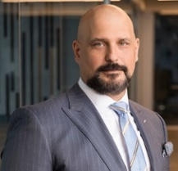
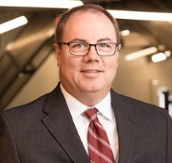
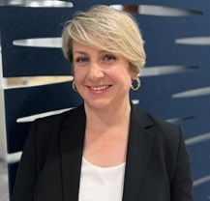
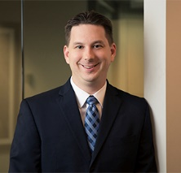
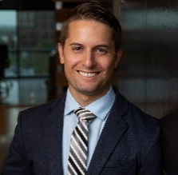
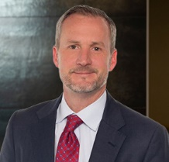
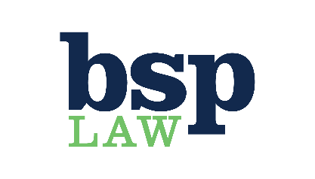
BSP Law’s Leadership Team
BSP Law’s team includes graduates of America's best law schools, former clerks from federal and state courts, and veterans of some of the country’s top law firms. They’re supported by skilled trial and discovery paralegals. Our diverse team is led by the following leadership team:
Patrick G. Seyferth
University of Michigan Law School
Clerkship: U.S. District Court for the Eastern District of Michigan
Moheeb H. Murray
University of Michigan Law School
Recipient of Oakland County Bar Association’s Distinguished Service Award
Roger P. Meyers
University of Michigan Law School
Clerkship: U.S. Court of Appeals for the Sixth Circuit
Stephanie A. Douglas
University of Michigan Law School
Clerkships: U.S. Court of Appeals for the Sixth Circuit & U.S. District Court for the Eastern District of Michigan
Amy Bice Larson
Brigham Young University J. Reuben Clark School of Law
Licensed and active in both Michigan and Texas
William E. McDonald, III
The Ohio State University Law School
Bill has experience working in-house at two Fortune 500 companies
Justin B. Weiner
The University of Chicago, The Law School
Clerkships: U.S. Court of Appeals for the Seventh Circuit & U.S. District Court for the Northern District of Illinois
Derek J. Linkous
Northwestern University School of Law
Clerkships: U.S. Court of Appeals for the Fifth Circuit & U.S. Court of Appeals for the Sixth Circuit
Andrew M. Mast
Wayne State University Law School
Inclusion in The Best Lawyers in America© Ones to Watch: Product Liability Litigation
Susan M. McKeever
Villanova School of Law
Clerkships: U.S. District Court for the Eastern District of Michigan & U.S. District Court for the District of New Jersey
Darin J. Lang
University of Nebraska-Lincoln School of Law
Licensed and active in North Carolina, New Mexico, Colorado and Nebraska
Bishop A. Bartoni
Michigan State University Detroit College of Law
Clerkship: State of Michigan 16th Judicial Circuit Court
About BSP Law
As a boutique firm, we leverage agility that larger firms often lack; at the same time, we have a nationwide practice, which allows us to gain practical insights from a variety of jurisdictions. Some of America’s best‐known companies trust BSP Law to represent them in catastrophic injury cases, class actions, complex business litigation, and appeals.
Troy, Michigan | Houston, Texas | bsplaw.com

